Slide 1
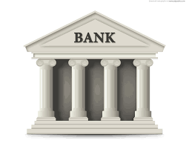


Working Capital Terms (WCT) – CAS Authorization Flow
1
USER INTERFACE (UI)
CM Bank
Account
2
6
CREDIT EDGE AR
COMMERCIAL LENDING PLATFORM (CLP)
3
7
DATAPOWER
(DP)
CM Loan sweep
9
BATCH update by CLP on CM Account AGE & EXPOSURE on WCT loans
AMEX WEB ROUTER
(AWR)
Communication / Network Layer
ENTERPRISE MONEY MOVEMENT (EMM)
8
GLOBAL AUTHORIZATION NETWORK (GAN)
CM Loan Payments
5
CREDIT AUTHORIZATION SYSTEM
(CAS)
LEGEND
4
CAS Logs
CAS AUTH Flow
4
IDN
CM Payment Flow
Exposure Appetite & MRC
CAS Logs

Slide 2
Working Capital Terms (WCT) – CAS Authorization Flow
1
Client request for payment to supplier
2
User interface (UI) with CLP to initiate a “Authorization” of loan request to pay to supplier
3
CLP formats a “1100” Authorization request via web-service (DP➔AWR➔GAN➔CAS)
4
CAS process request and logs all information for audit
5
CAS respond back to requester via “1110” (Approve/Deny) to CLP
6
CLP responds back to UI on confirmation on receipt of Client request
7
CLP sends a request to EMM to initiate Payment to supplier
8
EMM pays supplier
9
EMM responds back to CLP if supplier payment is successful or not
If payment not successful, CLP will initiate a “1420” Reversal request to CAS

